Slide 1
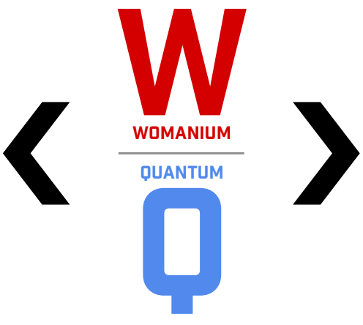

Womanium WISER Quantum Project
Project 1 – Quantum Walks and Monte carlo
Team-Q: Jesmer wong 20250808 v0
WISER Quantum Project

Slide 2
Agenda
Background on Random Walk, Monte Carlo, the Galton Box
Generalizing to n-layer quantum peg
Qiskit 2.0 implementation and results
General Galton board n-layer generalization
Variations on implementation – exponential distribution
Simulation with real hardware
References and Credits
WISER Quantum Project

Slide 3
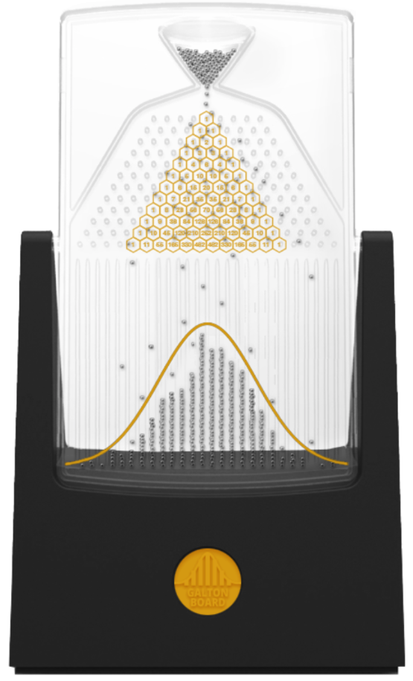

Background overview
The Galton board consists of a vertical board with interleaved rows of pegs. Beads are dropped from the top and, when the device is level, bounce either left or right as they hit the pegs. Eventually they are collected into bins at the bottom, where the height of bead columns accumulated in the bins approximate a bell curve.
Mathematically, this relates to the Pascal's triangle onto the pins shows the number of different paths that can be taken to get to each bin, and also to the Binomial Distribution that gives the discrete probability of entering into each bin, and further, when no. of beads goes large, by the Central Limit Theorem, its distribution will become Normal Distribution.
This modelling is extremely important for various applications including –
Finance: Stock market Monte Carlo simulation in form of Random Walk of signals, where no. of layers indicate the time duration.
System design: modelling of system uncertainty / reliability over time, etc.
N: Total number of beads, k: no. of beads successfully get into a designated bin
p: Probabillity of bouncing to one side. 0.5 if the bounce is non-biased, other values (between 0 and 1) if biased.
WISER Quantum Project

Slide 4
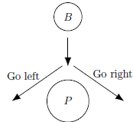
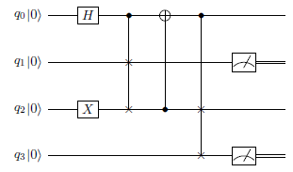
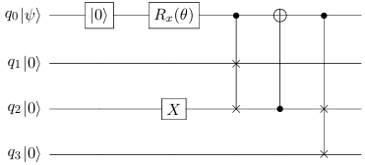

Quantum circuit implementation on Galton Board
As suggested by Mark and Ben, the one layer bouncing can be modelled by flipping the bit via SWAP gates.
This could then generalize to n-layer circuit.
Control qubit
“Right” with
probability 0.5
“Ball in”
OR
“Left” with
probability 0.5
Tune the bias here by introducing the Rx gate.
Higher values (0.5 < p < 1) then more probability to upper qubit (q1). Eg. A rotation of 2π/3 would be equivalent to probability of 0.75 since cos²(2π/3) = 0.75
B: Ball, P: Peg

Slide 5
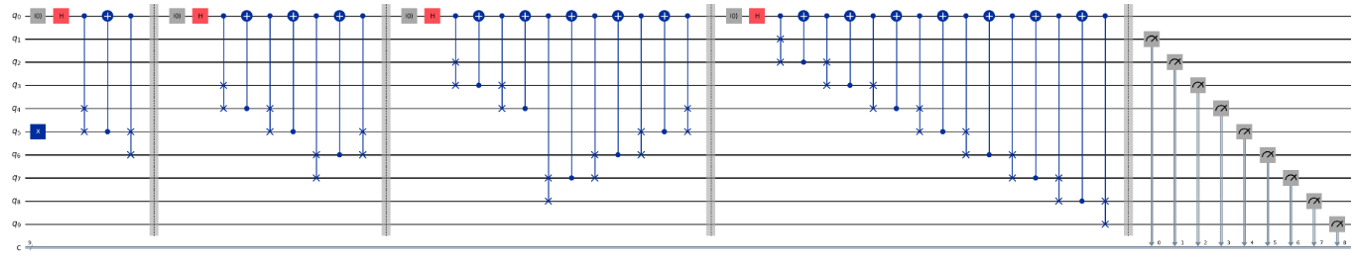
Generalizing to n-layer quantum peg (non-biased)
Input layer
Hidden layers (more than 3 pegs)
Output layer
Measure except qubit 0
This session mainly describes on non-biased n-layer generalization. For biased, will use Rx gate to replace the H gate.
WISER Quantum Project

Slide 6
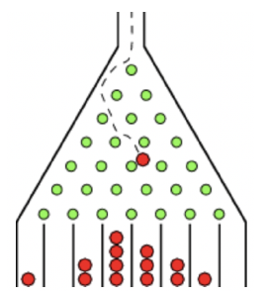
Generalizing to n-layer quantum peg (non-biased)
#3
“A”
“A”
“A”
“A”
#2
#4
Input layer
#1
This Input layer of the Quantum Circuit is analogous to the Input layer of the Quantum Galton Board, in form of a shot of Sampler that goes to left or right.
Owing to multiple layers of the Galton Board, this is suggested to be mimicked by inverting the middlemost qubit with an X gate, then construct a series of controlled SWAPs that the ball can flow through those arrays of pegs, as module “A”.
A biased probability on going left to right will replace the Hadamard gate by an Rx gate.
To generalize, every 1 extra layer needs 2 extra qubit is required. Eg. Above 4-layered circuit, needs 10 qubits. Formula on the general rule: no. of qubits = 4 + 2 x (n-2) layers is needed. (Because first peg needs 4 qubits. Note: n > 2.)
Input layer
WISER Quantum Project

Slide 7
Generalizing to n-layer quantum peg (non-biased)
“A”
“A”
“B”
“A”
“B”
“A”
Hidden layers
With the consideration of circuit depths, scaling out the qubits is optimized using a series hidden layers that could take the probability of half side on each qubit, storing that information on the control bit (q0) (red dot ), then doing the upper half (blue arrow ), and propagate the similar logic until covering the whole half, then reset it on each of the hidden layers. (Note: the blue arrow doesn’t contain the control qubit line q0.)
Also there are repeated swaps that bring the lower half’s (purple arrow ) information (yellow dot ) until it reaches the mid-point. This is identified as module “B” that continues the swap.
On generalizing to n-layers, n-2 layers of hidden layers are needed.
Hidden layers
WISER Quantum Project

Slide 8
Generalizing to n-layer quantum peg (non-biased)
“A”
“A”
“B”
“A”
“B”
“A”
“C”
Output layer
Finally the Output layer make sures all the entangled shots on are spread through all the qubit lines (except control bit). This is implemented as module “C” starting from the first peg.
When measuring the output, the corresponding pegs on the qubits are spaced out:
Spacer (q2)
Output layer
Control
Lower peg
Upper peg
WISER Quantum Project

Slide 9
Generalizing to n-layer quantum peg (non-biased)
Measure except qubit 0
Below simulators will be chosen, each with various circuit optimization levels:
A local provider – IBM Provider
Aer Simulator
A Fake Backend – eg. FakeSherBrooke
A Real Backend – IBM Torino / IBM Manila etc, selected by least_busy() function
Non-biased output will then be compared with the theoretical probability.
WISER Quantum Project

Slide 10
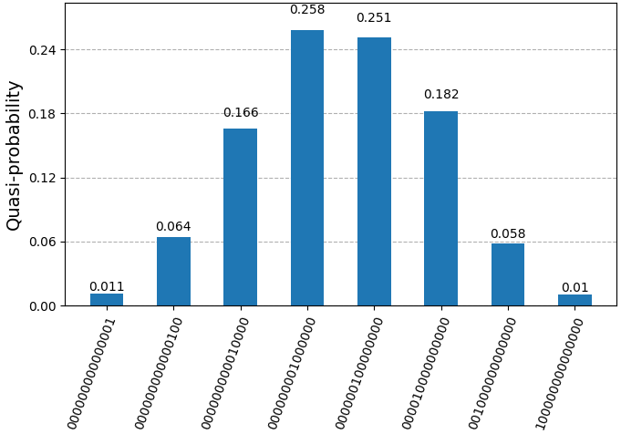
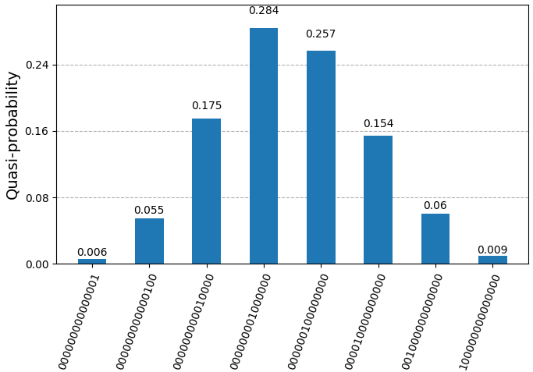
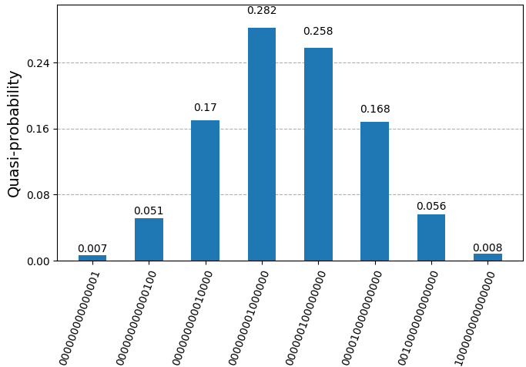
Qiskit 2.0 implementation and results
1. General Galton board n-layer generalization. Optimization level refers to circuit depth optimization to reduce decoherence, gate errors, crosstalk & measurement errors etc.
Non-biased
7-layers
(8 pegs)
1000 shots
Aer Simulator
optimization level = 1
Aer Simulator
optimization level = 2
Aer Simulator
optimization level = 3
Note that each output is separated by a qubit digit, ie. 1010101010101 for 7-layers
Theoretical probability for middle bin: ₈C₄ x 0.5⁴ x 0.5⁴ = 0.273.
WISER Quantum Project

Slide 11
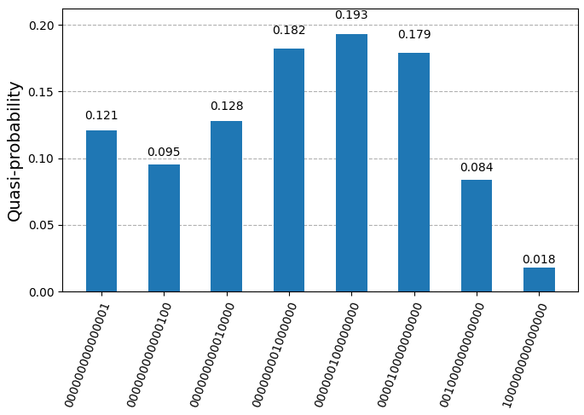
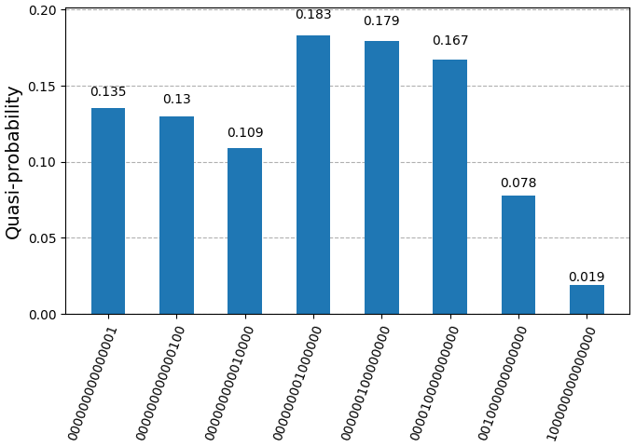
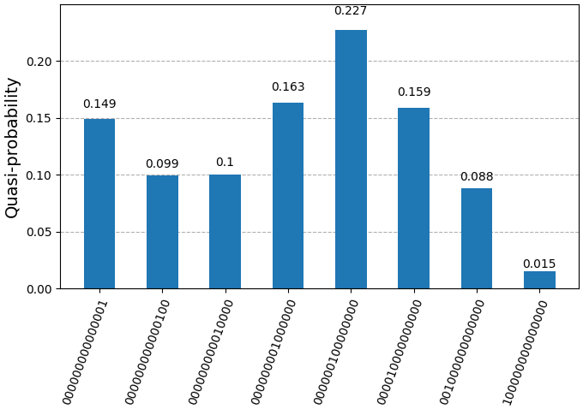
Qiskit 2.0 implementation and results
1. General Galton board n-layer generalization. Optimization level refers to circuit depth optimization to reduce decoherence, gate errors, crosstalk & measurement errors etc.
Biased
Θ = 2π/3
7-layers
1000 shots
Aer Simulator
optimization level = 1
Aer Simulator
optimization level = 2
Aer Simulator
optimization level = 3
WISER Quantum Project

Slide 12
Further work and applications
- Further work can be researched on modeling each pin’s probability by tailoring various layers’ rotations to model the actual simulation on different bombardment force from the ball on each pin when it enters into each layer.

Slide 13
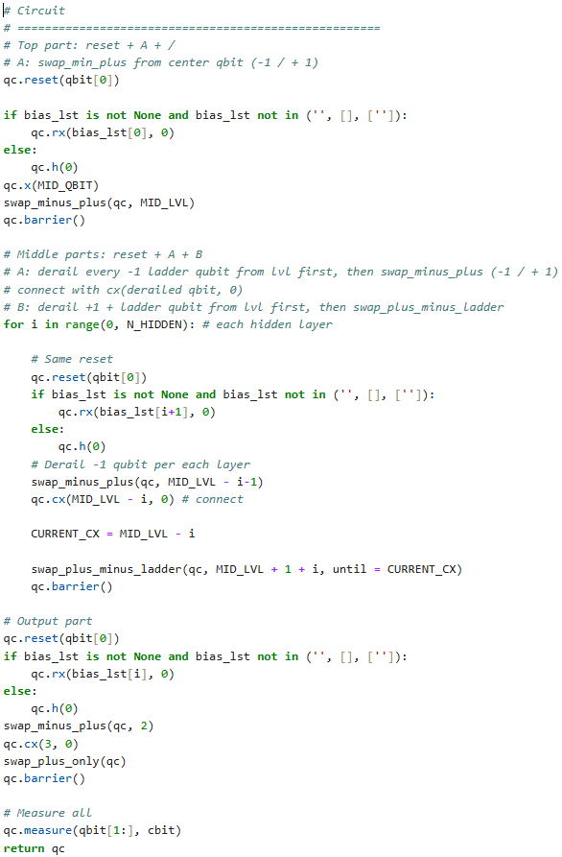
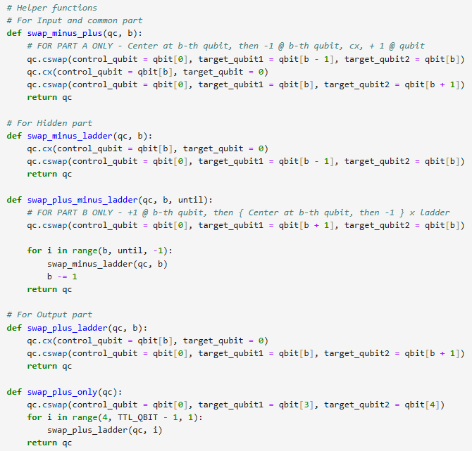
Code snippets – Quantum Circuit
WISER Quantum Project

Slide 14
References and Credits
Universal Statistical Simulator, Mark Carney, Ben Varcoe, arXiv:2202.01735
Qiskit v2.0 implementation and migration notes, IBM
Galton board, Wikipedia.
Galton board online experiment, https://gwern.net/doc/statistics/order/beanmachine-multistage/index.html
===
Github code & ppt on this project: https://github.com/jesmer/2025-wiser-proj1
===
I am grateful to have received bountiful information about this Quantum Monte Carlo Project. Great thanks to the WISER team for their insightful webinars from the Quantum Program. Special thanks to qBraid and IBM for providing the platform to code and simulate Quantum Circuits.
I wish I had more time to do all three projects – they all are immensely useful for industrial applications particularly on Finance and Logistics industries.
Thank you very much! Q&A
Jesmer Wong
jesmer.wong@gmail.com
https://www.linkedin.com/in/jesmerwong/
WISER Quantum Project

